Slide 1
Correlations Between
DevOps and Holacracy
Helen Beal – Ranger4 DevOpsologist
Soren Pedersen – LEGO

Slide 2
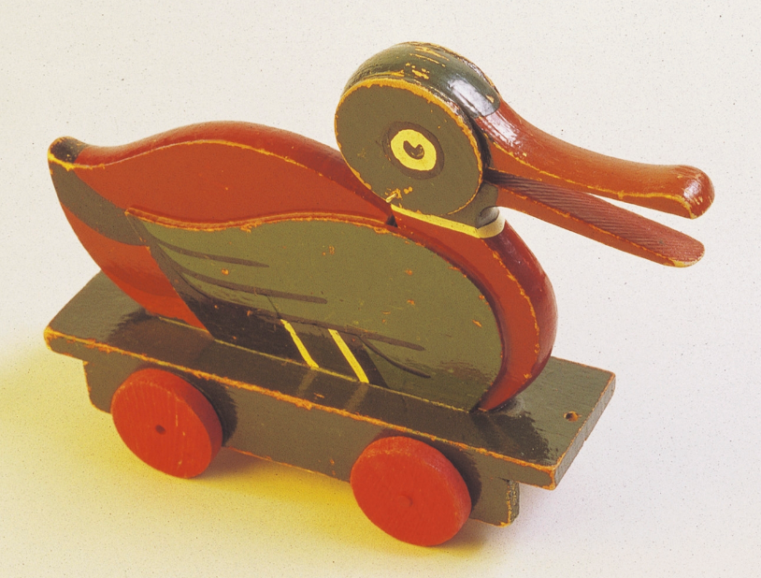
‘Inspire and develop the builders of tomorrow’

Slide 3
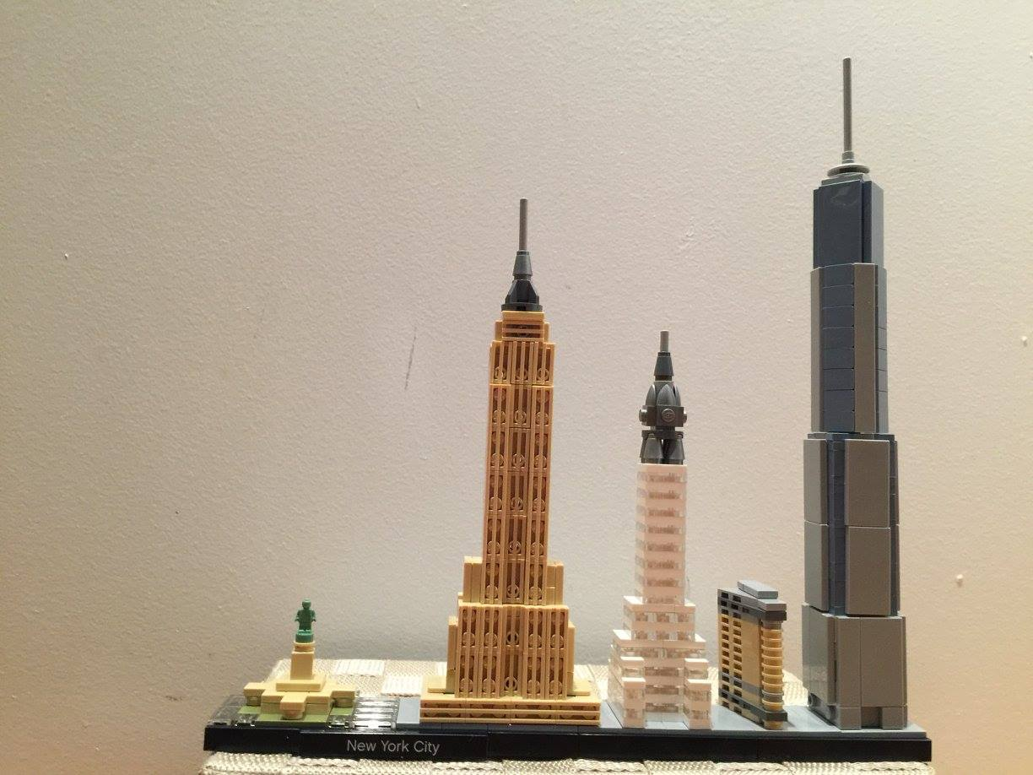
1932
4billon £ ’15
13.974 employees
10 years of sustained growth

Slide 4

“Traditional” IT
CIO
The rest of the business
Head of Development
Head of Operations
PMO/BAs
Dev
DBAs
Test
Security
Release
Infrastructure
Support
Silos, hand offs and a wall of confusion
Notes:
The commonest pattern we see on organisational charts of businesses that have been around for a while and are not IT led looks like this. We have distinct silos of development and operations – often when we visit customer sites we will see the development teams literally on a different side of a corridor or on a different floor from the operations teams – they are physically separated as well as organisationally. A Danish organisation I was talking with yesterday also told me how their teams are in different buildings on either side of the town where they are headquartered. But this organisational structure served us very adequately for a long time, surely, otherwise it wouldn’t be so prevalent. So why do we consider it to be broken now?

Slide 5
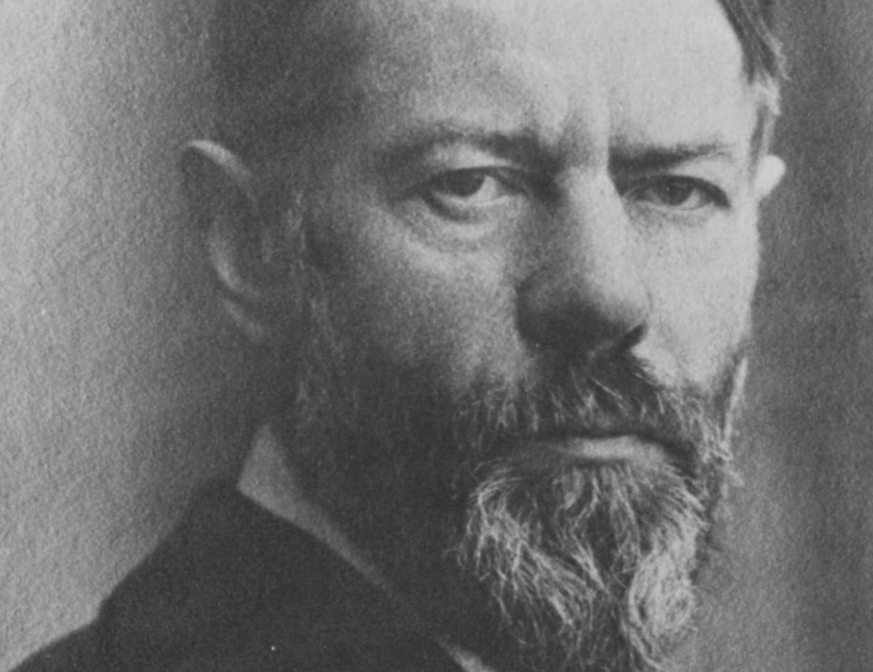
“Principles of official jurisdictional areas Every bureaucracy has its own special area: firemen do not arrest criminals, doctors do not empty bedpans, professors do not deliver mail.”
Max Weber

Slide 6
“The authority to give commands is distributed in a formal way and regulated.”
Max Weber

Slide 7
“Certain people have the right to control others, and this is spelled out clearly.”
Max Weber

Slide 8
“Methodical provision is made for the regular and continuous fulfillment of these duties; only persons who qualify under general rules are employed”
Max Weber

Slide 9
“…The work is a duty.”
Max Weber

Slide 10
Self-organising teams
Notes:
When the assessment happened, there weren’t self-organising teams, now some teams are in transition such as the search engine team. Agile is happening – fairly mature

Slide 11
No job titles, focus on roles

Slide 12
Flattened hierarchies and distributed authority

Slide 13


Slide 14
Peer based reviews
Notes:
This came out really strongly in the report – but it’s something that is challenging

Slide 15
Amplified feedback loops / processing tensions
Notes:
Transparency

Slide 16
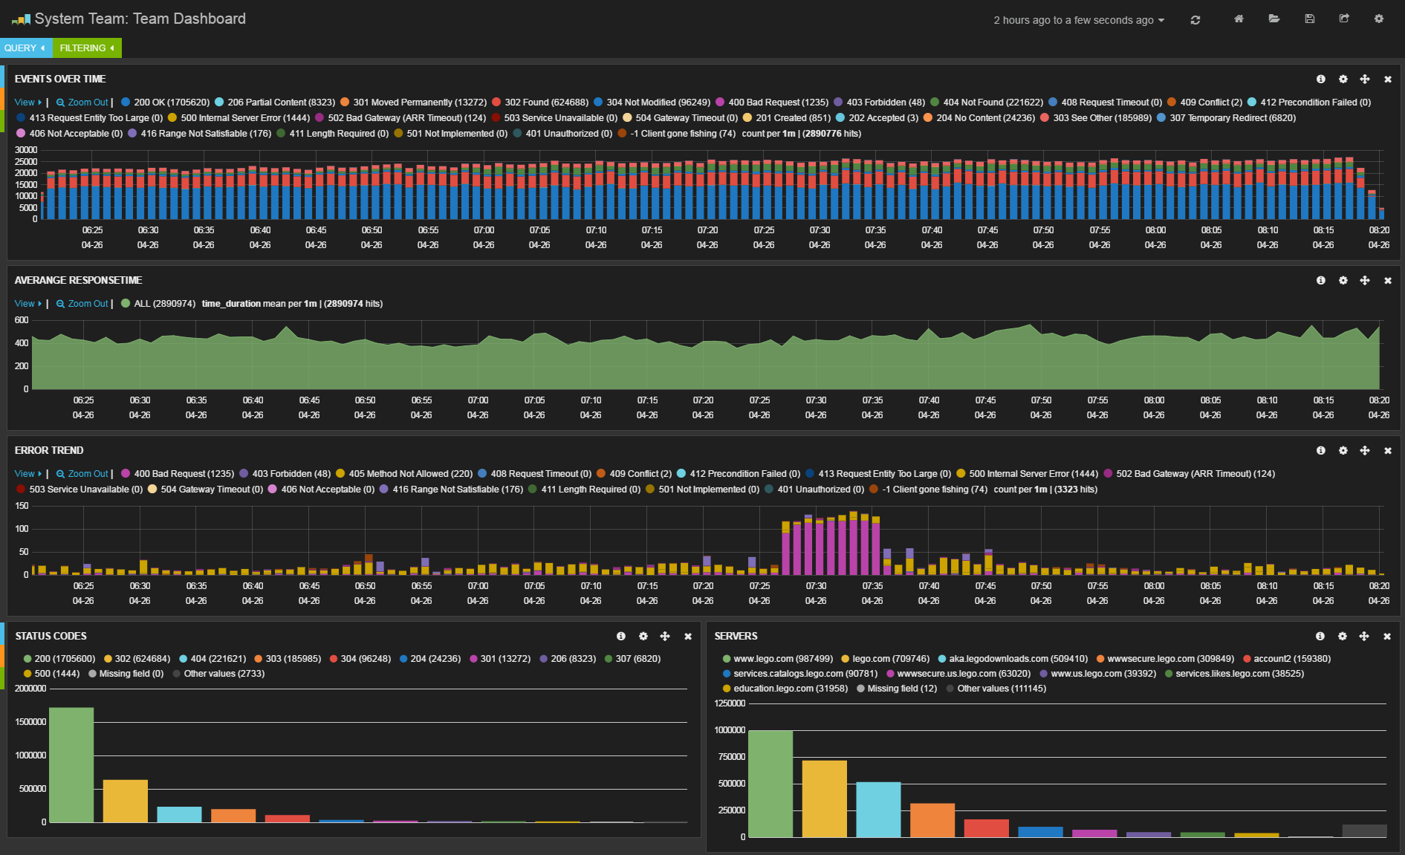

Slide 17
Continuous funding
Notes:
This came out really strongly in the report – but it’s something that is challenging

Slide 18
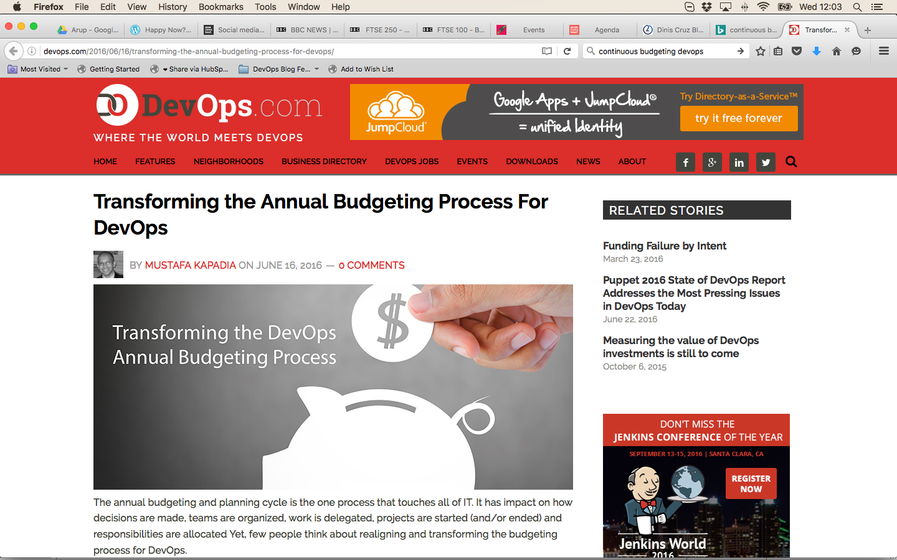
Notes:
http://devops.com/2016/06/16/transforming-the-annual-budgeting-process-for-devops/

Slide 19
Incremental, iterative improvement

Slide 20
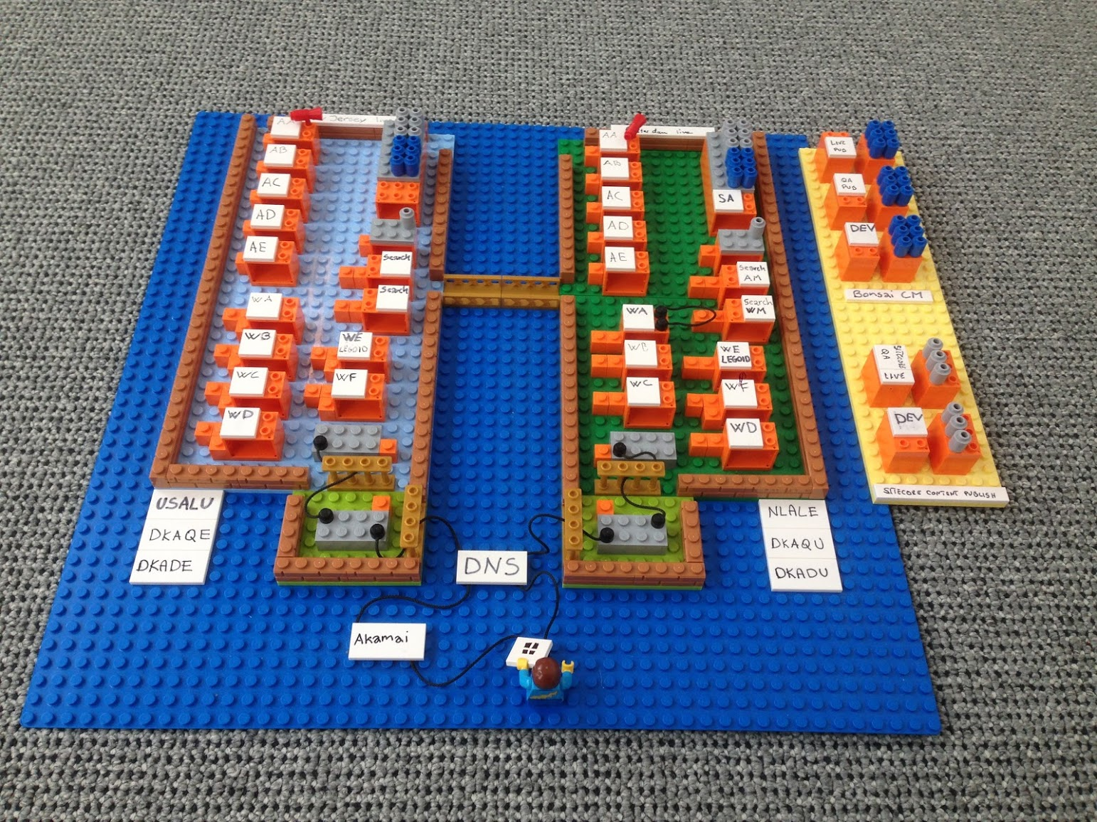
Notes:
The new dream we have called Data Driven DevOps.

Slide 21
Agile
Development
Service Management
Organisational Management

Slide 22

"The world as we have created it is a process of our thinking. It cannot be changed without changing our thinking."
Albert Einstein

Slide 23
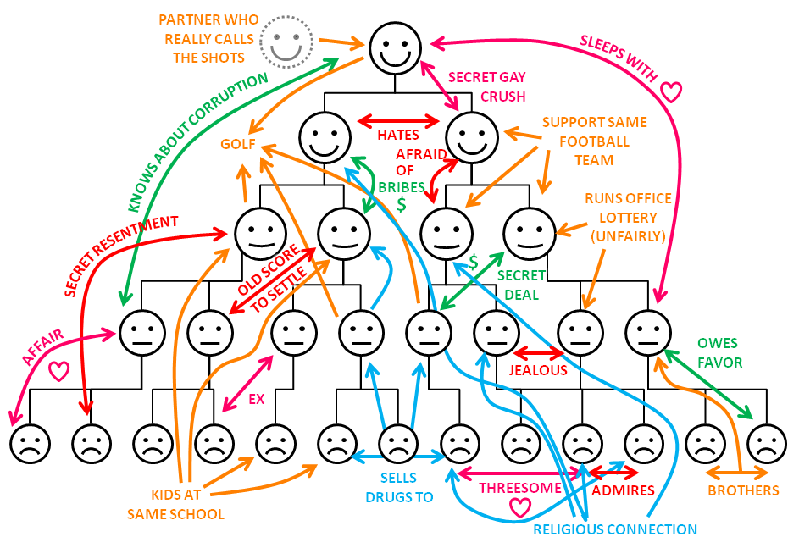
Organizing around people...

Slide 24
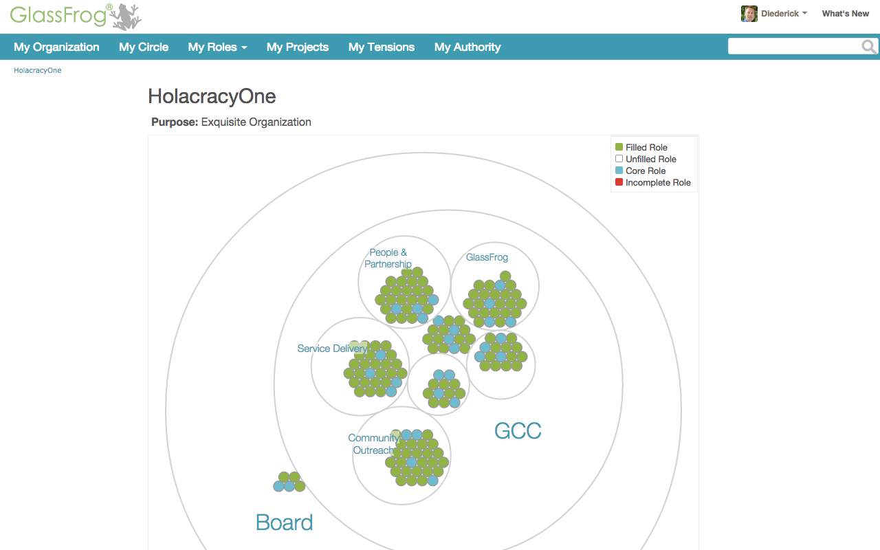
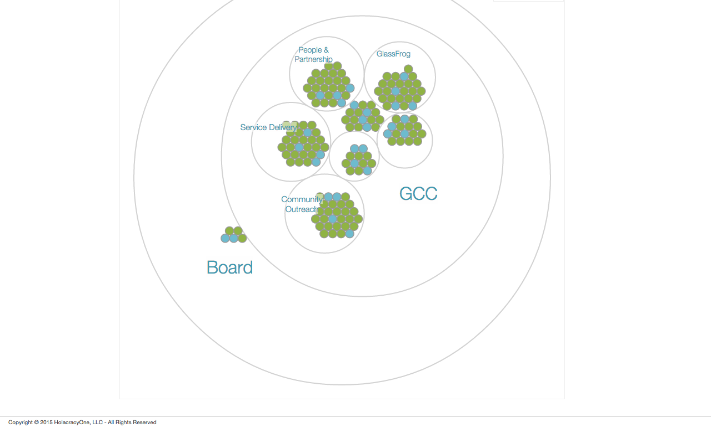
Notes:
See GlassFrog.com

Slide 25


Slide 26
“Holacracy structures your organisation for evolution.”

Slide 27
Be DevOpstastic

